Slide 1
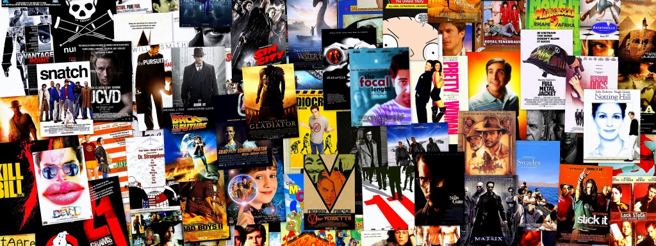
Textual Analysis of Movie Reviews Team 8

Slide 2





TFIDF
Term Frequency Inverse Document Frequency

Slide 3
Term Frequency Inverse Document Frequency
TF-IDF is the numerical statistic which determines the importance of a particular word to a document in a collection.
The value of Tfidf increases as the frequency of the word occurring in a document increases. However Tfidf is offset by the frequency in the corpus which helps to adjust for the fact that some words appear more frequently than others.

Slide 4
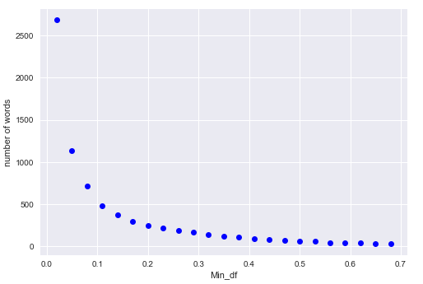
Minimum Document Frequency
It is the percentage threshold which defines the minimum document frequency allowed for every word in the corpus

Slide 5
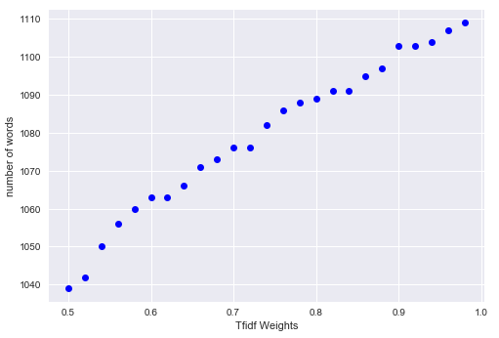
Maximum Document Frequency
It is the percentage threshold which defines the minimum document frequency allowed for every word in the corpus

Slide 6
N-Gram
N-gram is a contiguous sequence of n items from a given sequence of text or speech.
“ Hello I am on top of the World”

Slide 7
Machine learning
Linear SVC
K Nearest Neighbours

Slide 8
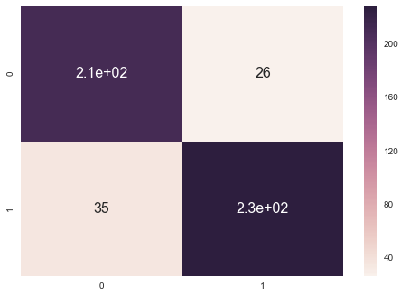
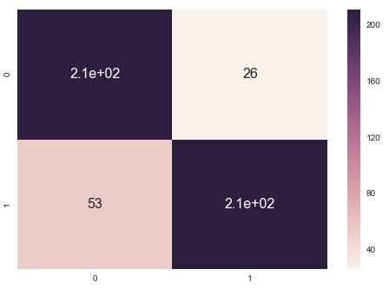
Linear SVC with Default Penalty | Linear SVC with Penalty = 0.1

Slide 9
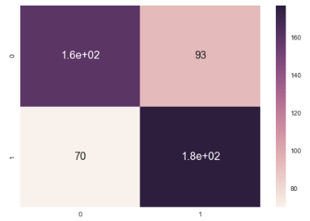
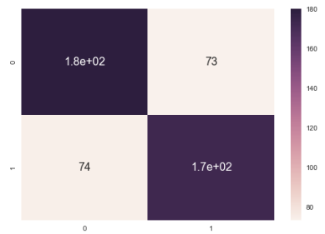
Knn with k=5 | Knn with k=10

Slide 10


Evaluation Metrics
False Positive
False Negative

Slide 11
Separate positive and negative reviews
We approached the problem as an unsupervised one
Process flow:
Transform data to matrix of TF-IDF scores
Separate into 2 clusters
Reduce the features to 2 dimensions
Visualize
Steps 2 and 3 were swapped in a few attempts

Slide 12
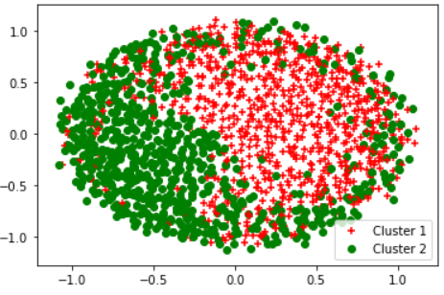
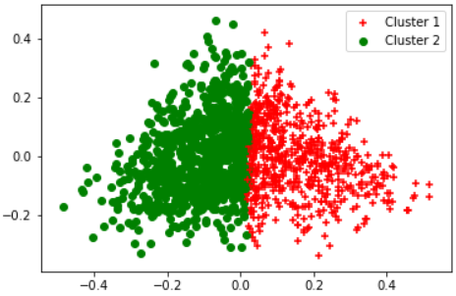
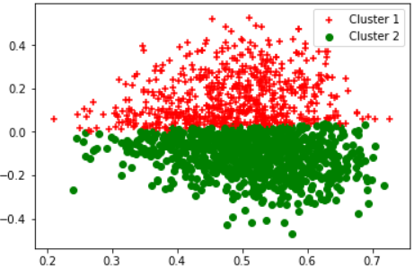
Using Spectral Clustering
Visualizing using Truncated Singular Value Decomposition
Visualizing using Multi-Dimensional Scaling
Visualizing using Principal Component Analysis
Accuracy : 0.51

Slide 13
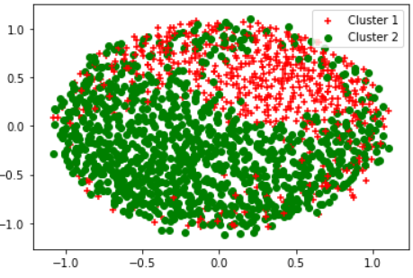
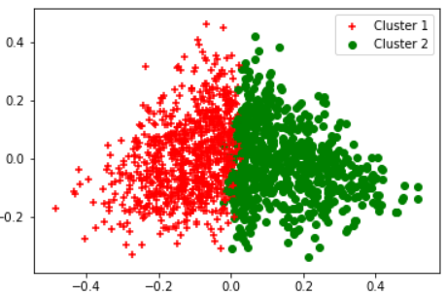
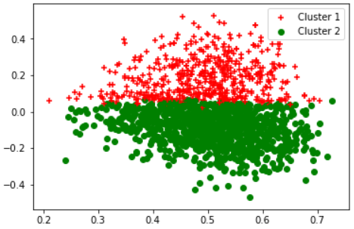
Using K-Means
Visualizing using Truncated Singular Value Decomposition
Visualizing using Multi-Dimensional Scaling
Visualizing using Principal Component Analysis
Accuracy : 0.43

Slide 14
Hierarchical Clustering
Average
Complete
Ward

Slide 15
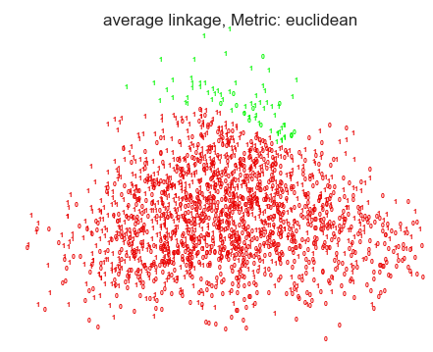
Using Average
Time Taken: 0.13s
Accuracy: 52.6%

Slide 16
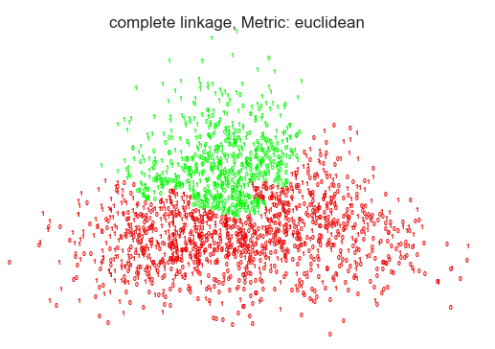
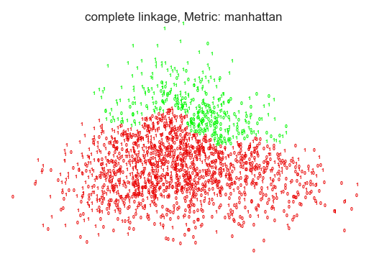
Using Complete
Euclidean:-
Time Taken: 0.11s
Accuracy: 58.35%
Manhattan:-
Time Taken: 0.12s
Accuracy: 55.45%

Slide 17
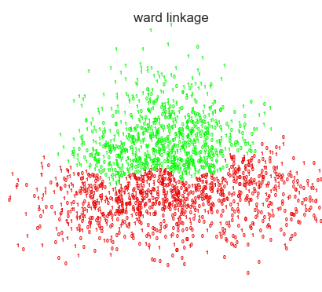
Using Ward
Time Taken: 0.14s
Accuracy: 59.55%
This was the best accuracy we achieved!!

Slide 18

Thank You

